Slide 1
Software Engineering for CS
Week 2
Instructor : Dr. Natash Ali Mian
School of Computer and Information Technology
Beaconhouse National University

Slide 2
`
Switch off mobile phones during lectures,
or
put them into silent mode

Slide 3
Software Lifecycle Models
The way you organize your activities
Lifecycle model is a series of steps through which the product progresses

Slide 4
Process Models
A process model is a simplified description of a process presented from a particular perspective
There may be several different models of the same process
No single model gives a complete understanding of the process being modeled

Slide 5
Variations in Process Models
A process model is produced on the anticipated need for that model. We may need
A model to help explain how process information has been organized
A model to help understand and improve a process
A model to satisfy some quality management standard

Slide 6
Software Life-Cycle Steps
Life-cycle model (formerly known as process model)
Requirements phase
Specification phase
Design phase
Implementation phase
Integration phase
Maintenance phase
Retirement

Slide 7
Different Lifecycle Models
Build-and-fix model
Waterfall model
Rapid prototyping model
Incremental model
Spiral model
Extreme programming
Object-oriented life-cycle models
Synchronize-and-stabilize model
Comparison of life-cycle models

Slide 8
Build and Fix Model
Build first
version
Modify until
client is satisfied
Maintenance
phase
Development
Retirement
Maintenance
Notes:
It is unfortunate that many products are developed using what is known as the build-and-fix model.
The product is constructed without specification or any attempt at design.
The developers simply build a product that is reworked as many times as necessary to satisfy the client.
May work for small projects but is totally unsatisfactory for products of any reasonable size.
The cost of build-and fix is actually far greater than the cost of properly specified and carefully designed product.
Maintenance of the product can be extremely in the absence of any documentation.

Slide 9
Build and Fix Model
It is unfortunate that many products are developed using what is known as the build-and-fix model.
The product is constructed without specification or any attempt at design.
The developers simply build a product that is reworked as many times as necessary to satisfy the client.
May work for small projects but is totally unsatisfactory for products of any reasonable size.
The cost of build-and fix is actually far greater than the cost of properly specified and carefully designed product.
Maintenance of the product can be extremely in the absence of any documentation.

Slide 10
Waterfall Model (Traditional)
Requirement
Definition
System and
Software Design
Implementation
and Unit Testing
Integration and
System Testing
Operation and
Maintenance
Notes:
The first published model of the software development process was derived from other engineering processes. Because of the cascade from one phase to another, this model is known as the waterfall model. This model is also known as linear sequential model. The principal stages of the model map directly onto fundamental development activities.
It suggests a systematic, sequential approach to software development that begins at the system level and progresses through the analysis, design, coding, testing, and maintenance.
In the literature, people have identified from 5 to 8 stages of software development.
The five stages above are as follows:
Requirement Analysis and Definition: What - The systems services, constraints and goals are established by consultation with system users. They are then defined in detail and serve as a system specification.
System and Software Design: How – The system design process partitions the requirements to either hardware of software systems. It establishes and overall system architecture. Software design involves fundamental system abstractions and their relationships.
Implementation and Unit Testing: - How – During this stage the software design is realized as a set of programs or program units. Unit testing involves verifying that each unit meets its specifications.
Integration and system testing: The individual program unit or programs are integrated and tested as a complete system to ensure that the software requirements have been met. After testing, the software system is delivered to the customer.
Operation and Maintenance: Normally this is the longest phase of the software life cycle. The system is installed and put into practical use. Maintenance involves correcting errors which were not discovered in earlier stages of the life-cycle, improving the implementation of system units and enhancing the system’s services as new requirements are discovered.
In principle, the result of each phase is one or more documents which are approved. No phase is complete until the documentation for that phase has been completed and products of that phase have been approved. The following phase should not start until the previous phase has finished.

Slide 11
Waterfall Model (1)
The first published model of the software development process was derived from other engineering processes. Because of the cascade from one phase to another, this model is known as the waterfall model. This model is also known as linear sequential model. The principal stages of the model map directly onto fundamental development activities.
It suggests a systematic, sequential approach to software development that begins at the system level and progresses through the analysis, design, coding, testing, and maintenance.
In the literature, people have identified from 5 to 8 stages of software development.

Slide 12
Waterfall Model (2)
The five stages above are as follows:
Requirement Analysis and Definition: What - The systems services, constraints and goals are established by consultation with system users. They are then defined in detail and serve as a system specification.
System and Software Design: How – The system design process partitions the requirements to either hardware of software systems. It establishes and overall system architecture. Software design involves fundamental system abstractions and their relationships.
Implementation and Unit Testing: - How – During this stage the software design is realized as a set of programs or program units. Unit testing involves verifying that each unit meets its specifications.

Slide 13
Waterfall Model (3)
Integration and system testing: The individual program unit or programs are integrated and tested as a complete system to ensure that the software requirements have been met. After testing, the software system is delivered to the customer.
Operation and Maintenance: Normally this is the longest phase of the software life cycle. The system is installed and put into practical use. Maintenance involves correcting errors which were not discovered in earlier stages of the life-cycle, improving the implementation of system units and enhancing the system’s services as new requirements are discovered.
In principle, the result of each phase is one or more documents which are approved. No phase is complete until the documentation for that phase has been completed and products of that phase have been approved. The following phase should not start until the previous phase has finished.

Slide 14
Waterfall Model (Modified)
Requirement
Definition
System and
Software Design
Implementation
and Unit Testing
Integration and
System Testing
Operation and
Maintenance
Notes:
Real projects rarely follow the sequential flow that the model proposes. In general these phases overlap and feed information to each other. Hence there should be an element of iteration and feedback. A mistake caught any stage should be referred back to the source and all the subsequent stages need to be revisited and corresponding documents should be updated accordingly.
Because of the costs of producing and approving documents, iterations are costly and require significant rework.

Slide 15
Rapid Prototyping Model
Rapid
Prototyping
Requirement
Definition
System and
Software Design
Implementation
and Unit Testing
Integration and
System Testing
Operation and
Maintenance
Notes:
Real projects rarely follow the sequential flow that the model proposes. In general these phases overlap and feed information to each other. Hence there should be an element of iteration and feedback. A mistake caught any stage should be referred back to the source and all the subsequent stages need to be revisited and corresponding documents should be updated accordingly.
Because of the costs of producing and approving documents, iterations are costly and require significant rework.

Slide 16
Rapid Prototyping Model
Real projects rarely follow the sequential flow that the model proposes.
In general these phases overlap and feed information to each other. Hence there should be an element of iteration and feedback.
A mistake caught any stage should be referred back to the source and all the subsequent stages need to be revisited and corresponding documents should be updated accordingly.
Because of the costs of producing and approving documents, iterations are costly and require significant rework.

Slide 17
Incremental Model
Requirements phase
Verify
Specification phase
Verify
Architectural design
Verify
For each build:
Perform detailed design, implementation and integration,
test, deliver to client
Maintenance phase
Development
Maintenance
Retirement

Slide 18
Incremental Model (cont.)
Build 1
Specification
Design
Implementation, integration
Deliver to client
Build 2
Specification
Design
Implementation, integration
Deliver to client
Build 3
Specification
Design
Implementation, integration
Deliver to client
Build n
Specification
Design
Implementation, integration
Deliver to client
Specification team
Implementation, integration team
Design team

Slide 19
Advantages
Generates working software quickly and early during the software life cycle.
This model is more flexible – less costly to change scope and requirements.
It is easier to test and debug during a smaller iteration.
In this model customer can respond to each built.
Lowers initial delivery cost.
Easier to manage risk because risky pieces are identified and handled during each iteration.

Slide 20
Disadvantages
Needs good planning and design.
Needs a clear and complete definition of the whole system before it can be broken down and built incrementally.
Total cost is higher than waterfall.

Slide 21
When to use the Incremental model:
This model can be used when the requirements of the complete system are clearly defined and understood.
Major requirements must be defined; however, some details can evolve with time.
There is a need to get a product to the market early.
A new technology is being used
Resources with needed skill set are not available
There are some high risk features and goals.

Slide 22
Risk and Risk Analysis
Risk: An uncertain event that may happen in the future and could cause negative impact.
In software engineering, a risk is a potential problem or uncertain event that may negatively affect a software project’s objectives (such as cost, schedule, quality, or performance) if it occurs.
Risk analysis is the process of identifying, assessing, and managing potential problems that could negatively affect a software project.
The aim is to anticipate issues before they occur and plan mitigation strategies to reduce their impact.

Slide 23
Risk Analysis (Types of Risks)
Project Risks – threats to project schedule, budget, resources, or people.
Example: Key developer leaving mid-project.
Technical Risks – issues with technology, tools, or implementation.
Example: New framework not scaling under load.
Business Risks – risks that affect product acceptance or success.
Example: Customer requirements changing after release.
Operational Risks – risks related to environment, infrastructure, or deployment.
Example: Server downtime or data center failure.

Slide 24
Risk Analysis (Steps)
Risk Identification: Brainstorm potential risks using past projects, checklists, and expert input.
Risk Assessment (Analysis): Estimate likelihood (probability) of risk occurrence.
Estimate impact (consequence) if the risk happens.
Combine them into a risk exposure measure (Risk = Probability × Impact).
Risk Prioritization: Rank risks by severity to focus on critical ones first.
Often visualized using a Risk Matrix (Low/Medium/High probability vs impact).
Risk Mitigation (Planning): Define strategies such as:
Avoidance (change plan to eliminate risk).
Mitigation (reduce probability or impact).
Transfer (shift risk to third party, e.g., insurance).
Acceptance (acknowledge and prepare for recovery).

Slide 25
Risk Analysis (Steps)
Risk Monitoring & Control: Continuously track risks throughout the project.
Update plans when risks evolve.
Example
Risk: Delivery deadline may slip due to underestimated complexity.
Probability: High
Impact: Severe (missed client deadline)
Mitigation: Add buffer time, hire an extra developer, or reduce non-critical features.
Risk analysis in software engineering is about foreseeing potential problems, evaluating their severity, and planning actions to handle them so projects stay on track.

Slide 26
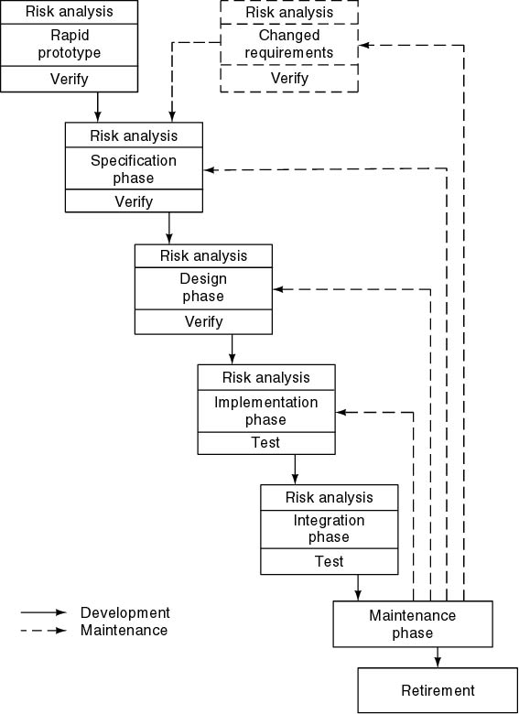
Spiral Model
Precede each phase by
Alternatives
Risk analysis
Follow each phase by
Evaluation
Planning of next phase

Slide 27
Spiral Model – Overview
Proposed by Barry Boehm (1986)
Combines iterative development with systematic risk analysis
Project progresses through repeated cycles (spirals)
Each spiral has 4 phases: Planning, Risk Analysis, Engineering, Evaluation

Slide 28
Key Characteristics
Risk-driven approach to software development
Each iteration delivers a more complete system
Suitable for large, complex, and high-risk projects
Customer feedback is emphasized at each stage

Slide 29
Advantages of Spiral Model
Strong focus on risk management
Early detection of errors and issues
Encourages customer involvement throughout
Accommodates changing requirements
Well-suited for large and mission-critical systems

Slide 30
Disadvantages of Spiral Model
Expensive due to repeated risk analysis and iterations
Requires expertise in risk assessment
Not suitable for small or low-risk projects
Time-consuming and complex to manage
Heavily dependent on quality of risk analysis

Slide 31
Examples of Spiral Model Use
Developing banking software where security risks must be carefully managed
Creating aerospace systems (e.g., NASA projects) requiring reliability and risk analysis
Designing large enterprise ERPs where requirements evolve gradually
Game development where continuous feedback and prototyping are important

Slide 32
Simplified Spiral Model
Risk Analysis
If risks cannot be resolved, project is immediately terminated
Rapid Prototype
Specification
Design
Implementation
Verify
Integration

Slide 33
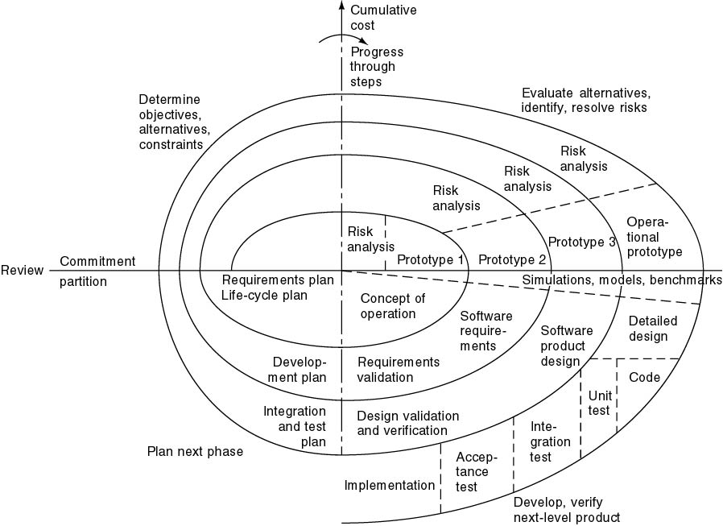
Full Spiral Model
Angular dimension (progress)
Radial dimension (cost)

Slide 34
Extreme Programming (XP) – Overview
Introduced by Kent Beck in the 1990s.
An agile software development methodology.
Focuses on customer satisfaction, flexibility, and teamwork.
Emphasizes short development cycles, frequent releases, and continuous feedback.
Encourages simple design, coding standards, and close customer-developer collaboration.

Slide 35
Key Practices in XP
Pair Programming – two developers work together on the same code.
Continuous Integration – code integrated and tested frequently.
Small Releases – frequent delivery of working software.
Refactoring – continuous improvement of code structure.
Collective Code Ownership – anyone can improve any part of the code.
40-Hour Work Week – avoid burnout by maintaining sustainable pace.
On-Site Customer – customer representative is always available for feedback.

Slide 36
Advantages of XP
Ensures high customer satisfaction through continuous involvement.
Early delivery of working software.
Improves code quality through refactoring, and pair programming.
Highly adaptable to changing requirements.
Promotes team collaboration and communication.
Reduces risks by catching defects early.

Slide 37
Disadvantages of XP
High customer involvement required (may not always be feasible).
Difficult to manage in large, distributed teams.
Can be costly due to pair programming and frequent testing.
Lacks emphasis on formal documentation.
May not work well for projects with fixed scope and deadlines.
Requires developers with strong communication and technical skills.

Slide 38
Examples of XP Use
Startup product development – frequent changes, evolving needs.
Web & mobile apps requiring quick releases.
Game development with continuous testing and feedback.
Projects with unclear or dynamic requirements.

Slide 39
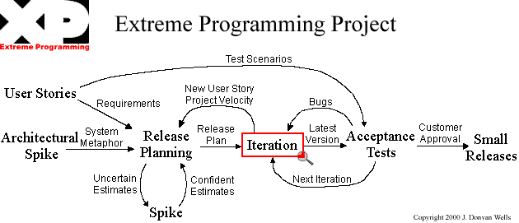
Extreme Programming

Slide 40
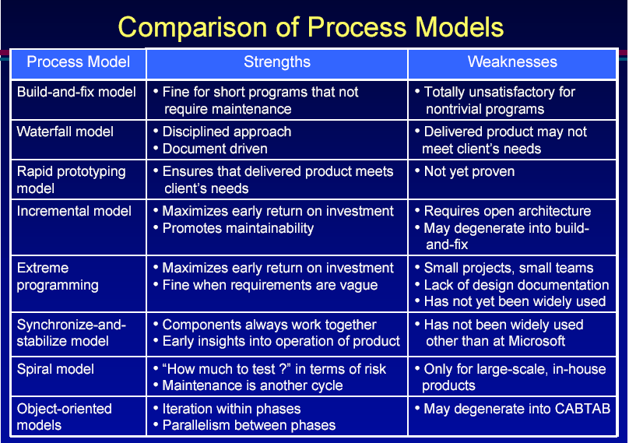

Slide 41
Documentation Phase?
There is NO documentation phase
Every phase must be fully documented before starting the next phase
Postponed documentation may never be completed
The responsible individual may leave
The product is constantly changing—we need the documentation to do this
The design (for example) will be modified during development, but the original designers may not be available to document it

Slide 42
Phase | Documents | QA
Requirement Definition | Rapid prototype, or Requirements document | Rapid prototype Reviews
Functional Specification | Specification document (specifications) Software Product Management Plan | Traceability FS Review Check the SPMP
Design | Architectural Design Detailed Design | Traceability Review
Coding | Source code Test cases | Traceability Review Testing
Integration | Source code Test cases | Integration testing Acceptance testing
Maintenance | Change record Regression test cases | Regression testing

Slide 43
Conclusions
Different life-cycle models
Each with own strengths
Each with own weaknesses
Criteria for deciding on a model include
The organization
Its management
Skills of the employees
The nature of the product
Best suggestion
“Mix-and-match” life-cycle model

Slide 44
Thanks

